Slide 1
S2. Economics of Environnement Earth Summit, IPCC and COP
Xavier Timbeau
xavier.timbeau@sciencespo.fr

Slide 2
Precautionary principle
Earth Summit
IPCC

Slide 3
Precautinary principle, large scale damages
Silent spring, R. Carlson, 1962
Pesticide, pollution killing birds and wild life
Acid rains, destruction of forest
Laws on water&air pollutions passed in most countries during these times
Hans Jonas : responsibility principle (1979) (precautionary principle)
Moving principle, elaborated firstly in Germany
1976 : “Environment policy does not confine to prepare for imminent danger or to repair damages when done. A precautionary environment policy intend to protect and manage with care natural resources”
1986 : german laws
1984, north sea countries summit in Brême: “States should not wait to act that damage is assessed”
Wiki : the precautionary principle states that if an action or policy has a suspected risk of causing harm to the public or to the environment, in the absence of scientific consensus that the action or policy is harmful, the burden of proof that it is not harmful falls on those taking the action.

Slide 4
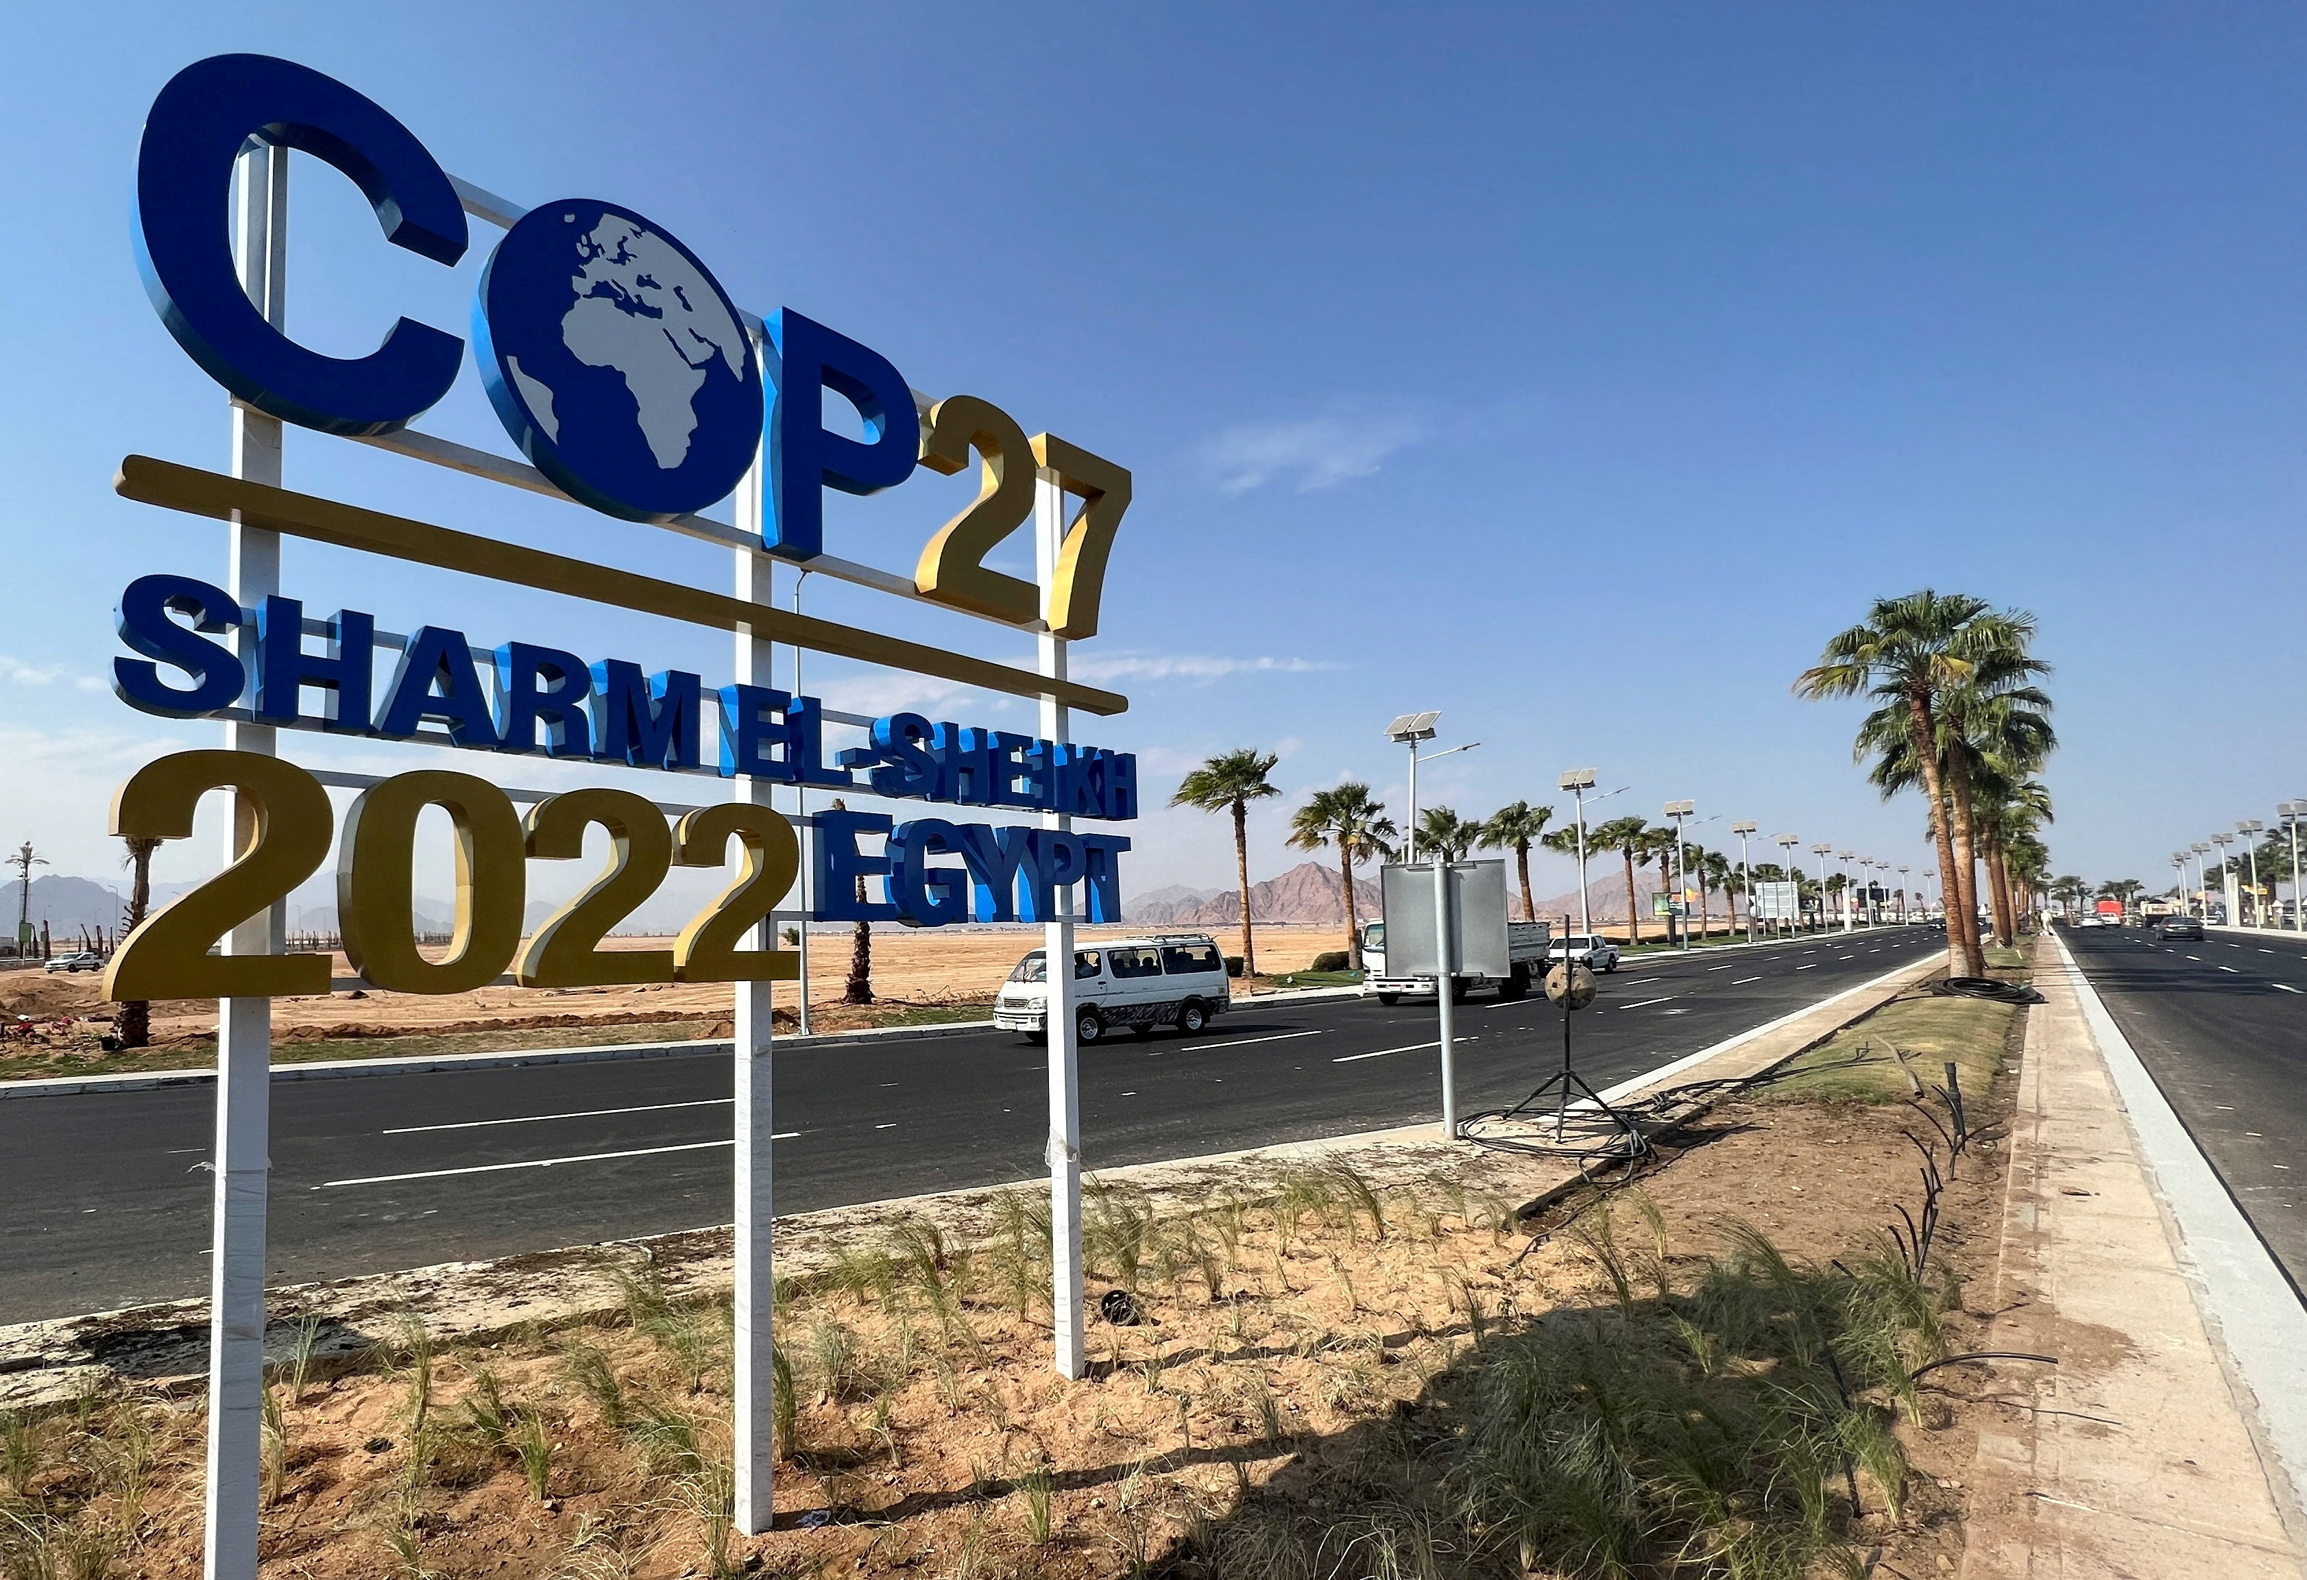
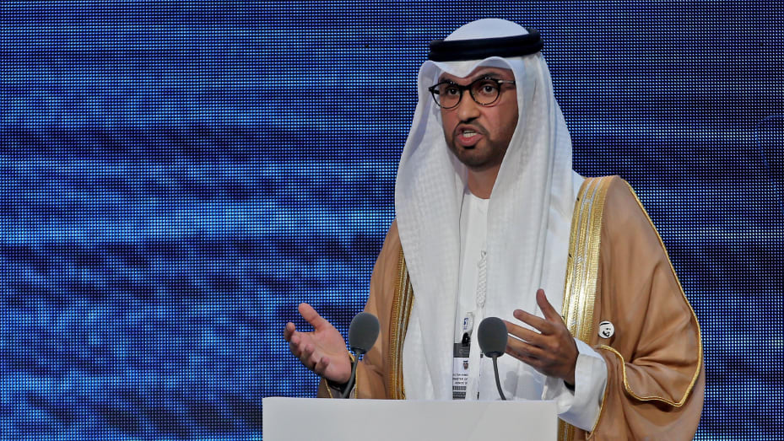
Earth summits
1972: Stockholm
1982 : Nairobi
Failure, R.Reagan daughter is US delegate !
1992 : Rio (Earth) summit
3 pillars economic progress, social justice and environment protection
Main principles
1. humans are central.
2. State are sovereign
3. Right to development
4. Environmental Protection in the Development Process
5. Eradication of Poverty
6. Priority for the Least Developed
13. Compensation for Victims of Pollution and other Environmental Damage
15. Precautionary principle
Kyoto protocol is a consequence of the Rio Summit
2002 : Johannesburg Summit
« Notre maison brûle et nous regardons ailleurs »
2009 : Copenhagen : climate change summit (Kyoto 2.0), Bonn, Cancun to follow
No binding agreement, 2°C target, conflict over surveillance and cost
2012 : Rio+20
2015 : Paris Conference of Parties #21
2021 : COP26 initially scheduled in 2020, postponed in 2021, 5 years after COP21, renewed pledges
2022 : Sharm el Cheik
2023 : United Arab Emirates (!), Sultan al-Jaber, head of Abu Dhabi National Oil Company presided
2024 : Azerbaidjan

Slide 5
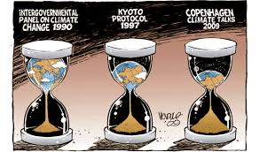
Sustainable Development
1983-1987 : Brundtland commission, Our common future,
Sustainable development is development that meets the needs of the present without compromising the ability of future generations to meet their own needs. It contains within it two key concepts:the concept of 'needs', in particular the essential needs of the world's poor, to which overriding priority should be given; and the idea of limitations imposed by the state of technology and social organization on the environment's ability to meet present and future needs

Slide 6
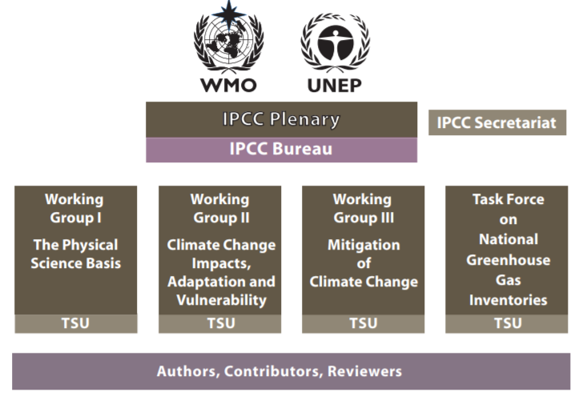
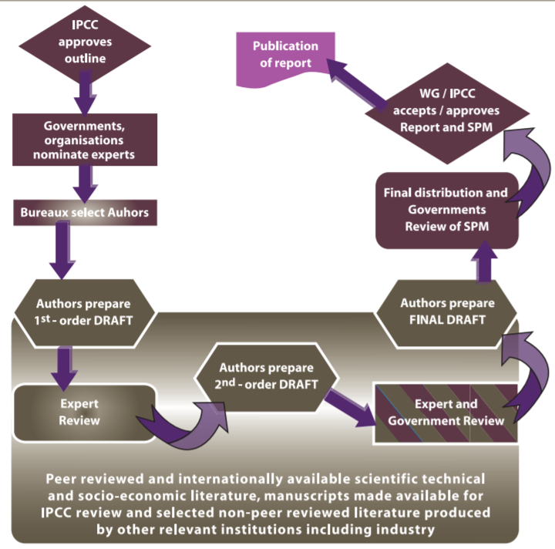
IPCC: the modern Manhattan project
1988 international panel on climate change (http://www.ipcc.ch/)
Complex governance
All countries (gvt) accept to use scientific knowledge to deal with climate change
A common report is established (by gvt, executive summary) based only on material provided by scientists. Redactors have the last word. Material could only be peer reviewed published material. All modifications are made public.
3 working groups+some
I. Climate change: heavily science based, peer review
II. Impact on ecosystems and human societies, adaptation
III. Mitigation and economics
TFI : Task force on National Greenhouse Gas Inventories
6+1 reports
1990: Green House effect detection based on observations is unlikely in the next decades, Science needs some work
1995: Evidence points toward an impact of human activity on global climate. The trigger for the Kyoto protocol at COP-2 in 1996
2001: There are strong evidence of antrhopogenic climate change over the last 50 years, COP 8 significant cuts needed
2007: There is no doubt (unequivocal) the human activity causes climate change (Peace Nobel Prize)
2013-14: A lot of more work done on all details, Ice sheet, sea level rise, socio economic aspects
2018: +1.5°C is a better target, it requires strong action
2022: AR6, less and less time left
No direct funding (or nearly) for science
But has given a lot of attention to earth science, with a lot of money and an unprecedented research effort

Slide 7
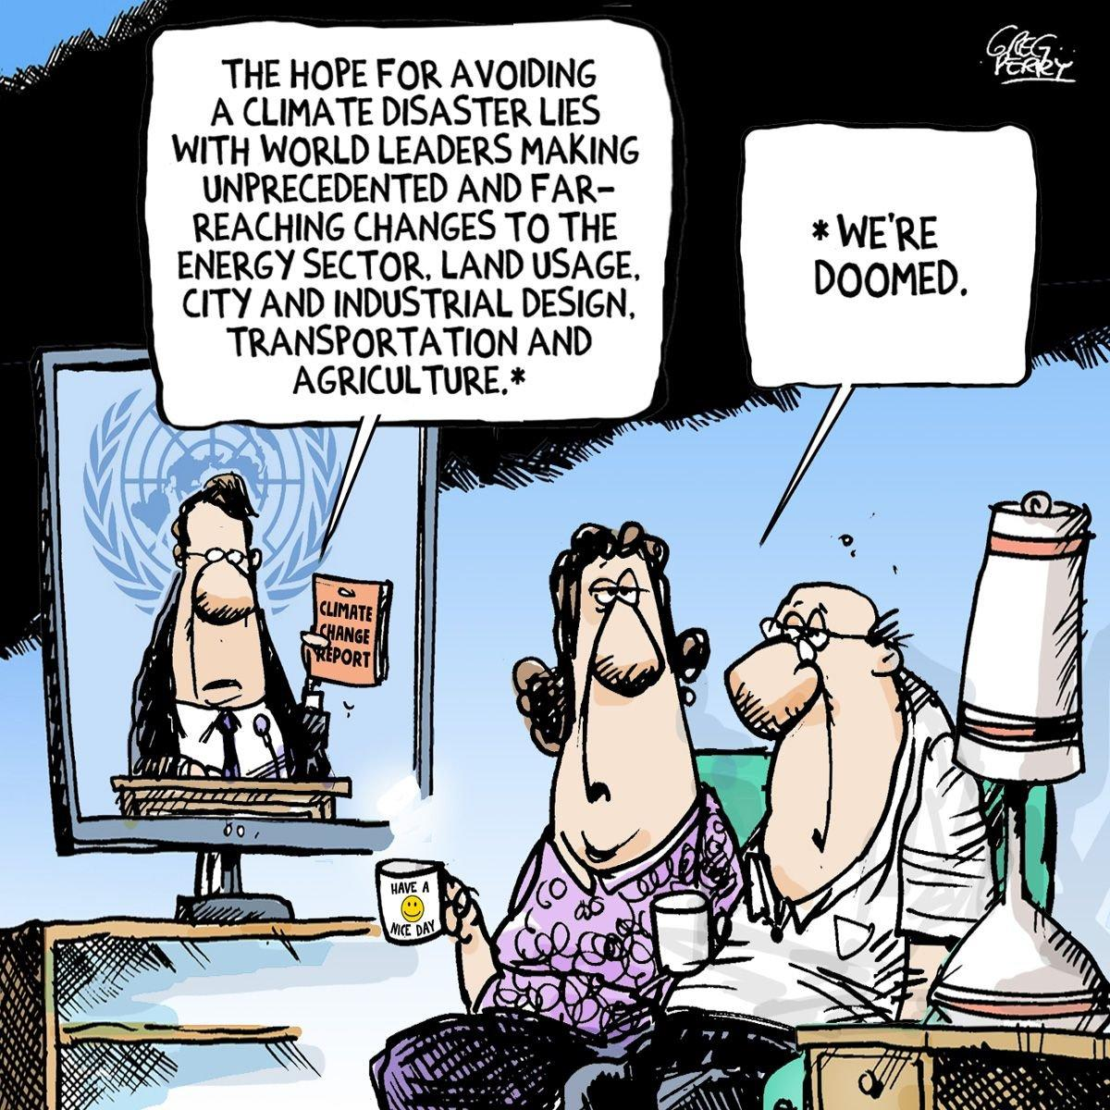
Good evening !

